Slide 1


Fundamentals of Music Processing
Chapter 8: Musically Informed Audio Decomposition
Meinard Müller
International Audio Laboratories Erlangen
www.music-processing.de

Slide 2
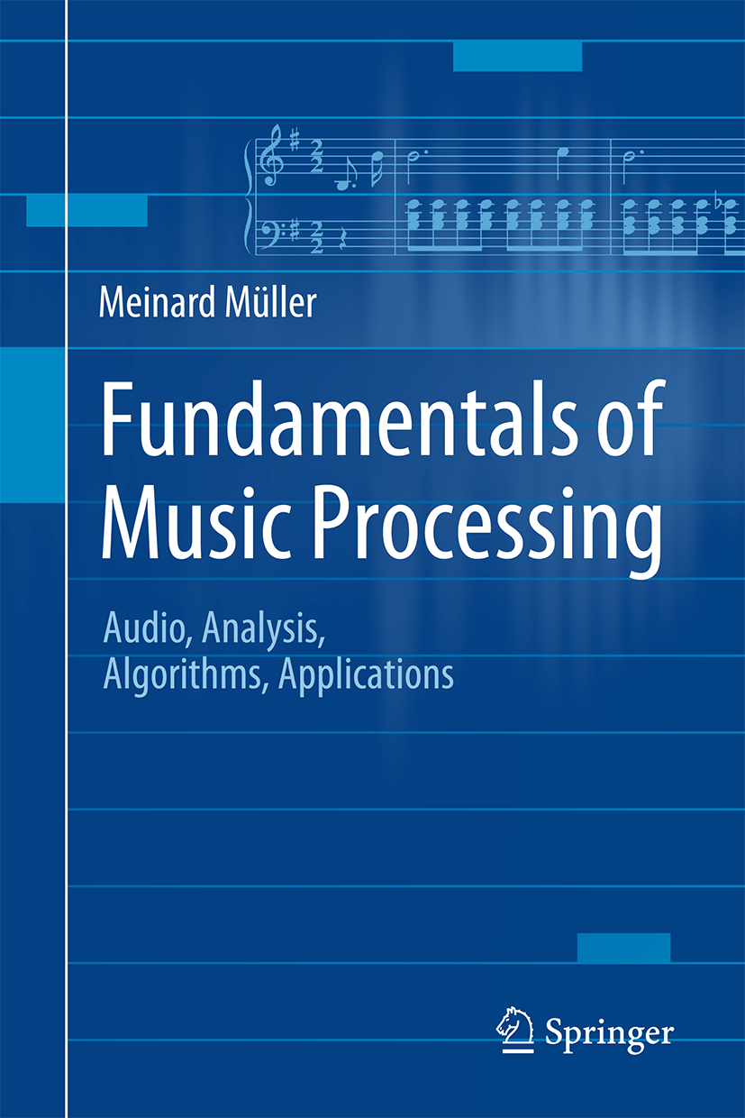

Book: Fundamentals of Music Processing
Meinard Müller
Fundamentals of Music Processing
Audio, Analysis, Algorithms, Applications
483 p., 249 illus., 30 illus. in color, hardcover
ISBN: 978-3-319-21944-8
Springer, 2015
Accompanying website:
www.music-processing.de

Slide 3
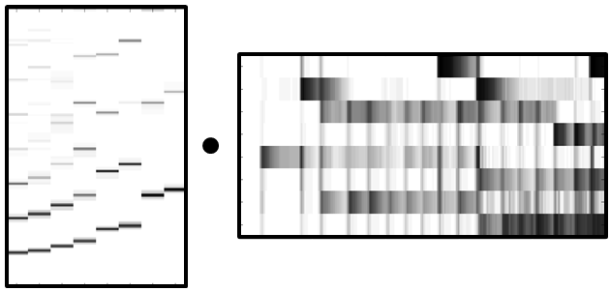
Chapter 8: Musically Informed Audio Decomposition
8.1 Harmonic-Percussive Separation
8.2 Melody Extraction
8.3 NMF-Based Audio Decomposition
8.4 Further Notes
In the final Chapter 8 on audio decomposition, we present a challenging research direction that is closely related to source separation. Within this wide research area, we consider three subproblems: harmonic–percussive separation, main melody extraction, and score-informed audio decomposition. Within these scenarios, we discuss a number of key techniques including instantaneous frequency estimation, fundamental frequency (F0) estimation, spectrogram inversion, and nonnegative matrix factorization (NMF). Furthermore, we encounter a number of acoustic and musical properties of audio recordings that have been introduced and discussed in previous chapters, which rounds off the book.

Slide 4
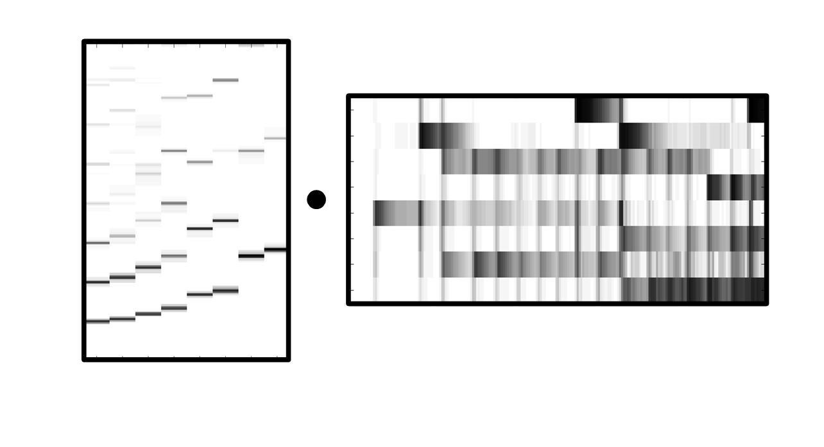
8 Content-Based Audio Retrieval
Teaser

Slide 5
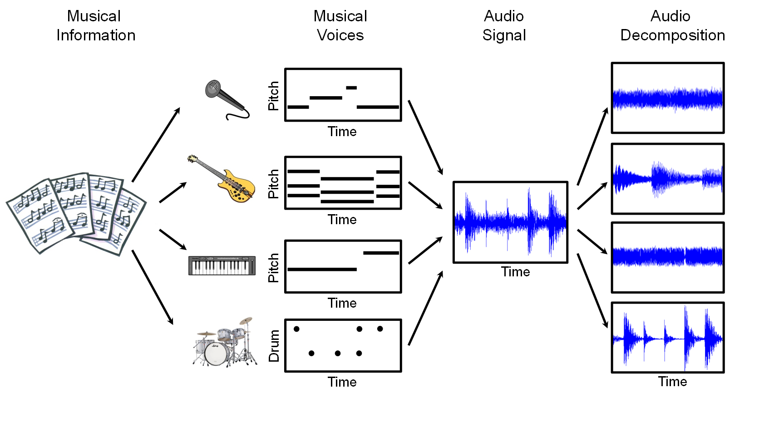
8 Content-Based Audio Retrieval
Fig. 8.1

Slide 6
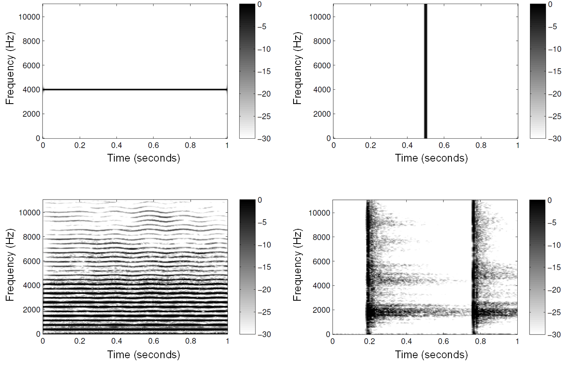
8.1 Harmonic–Percussive Separation
Fig. 8.2

Slide 7
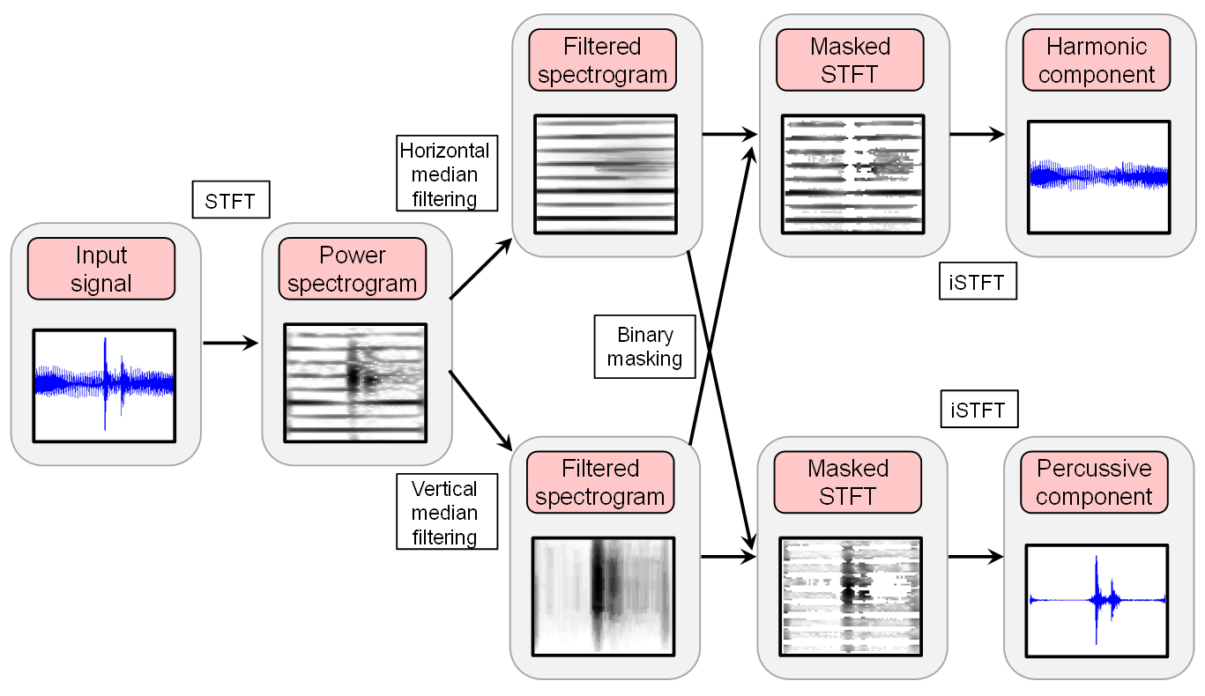
8.1 Harmonic–Percussive Separation
Fig. 8.3

Slide 8
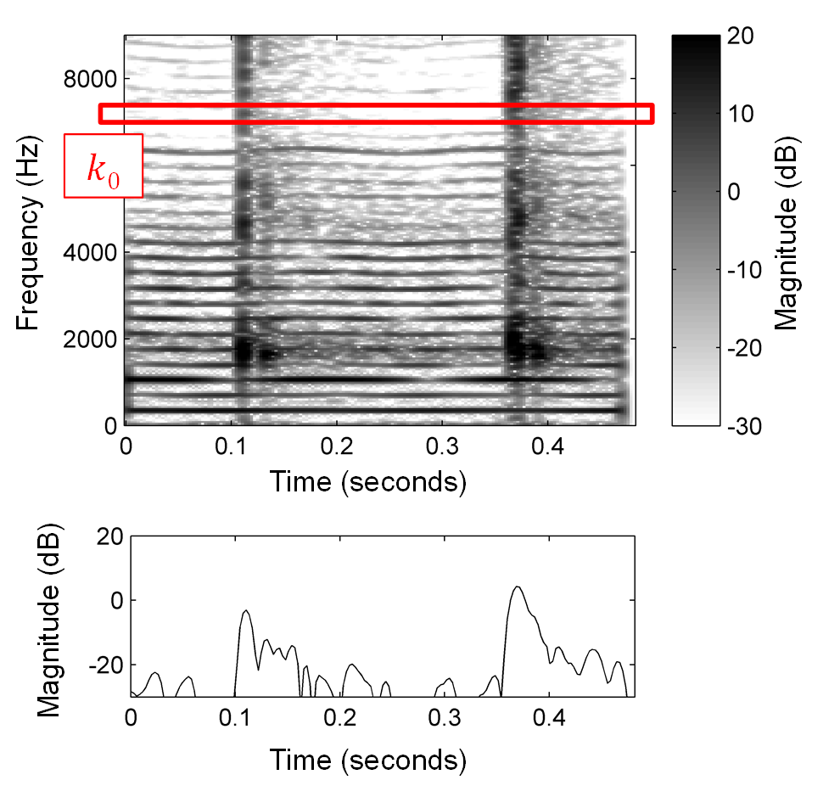
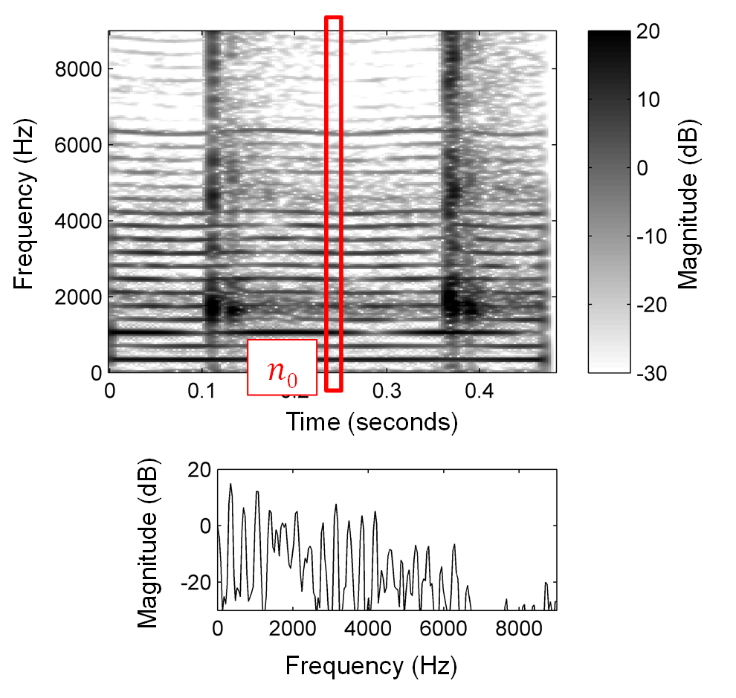
8.1 Harmonic–Percussive Separation
Fig. 8.4

Slide 9
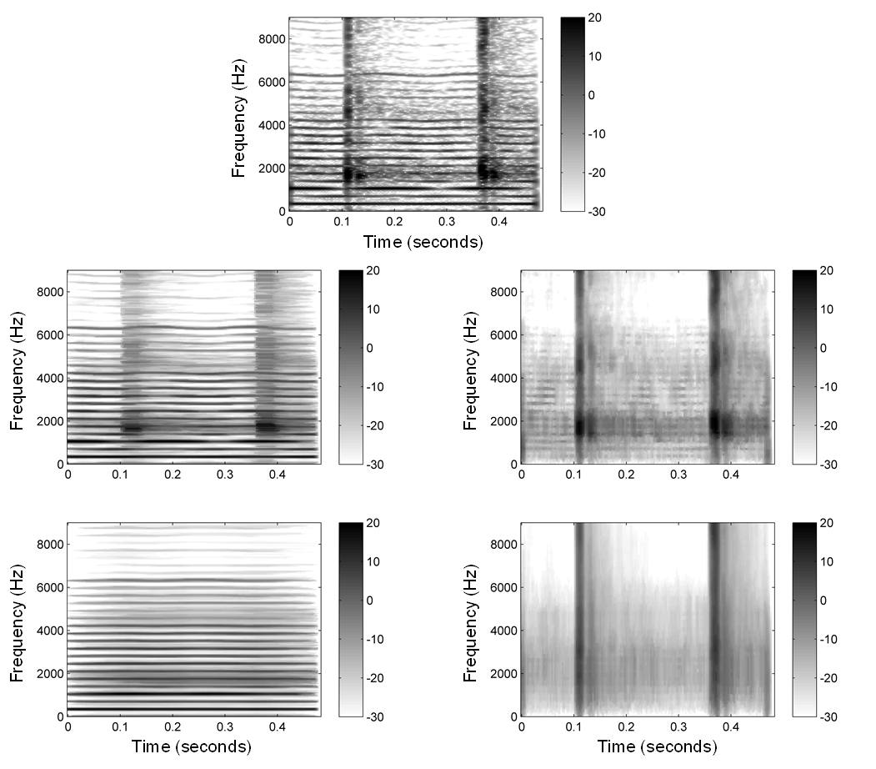
8.1 Harmonic–Percussive Separation
Fig. 8.5

Slide 10
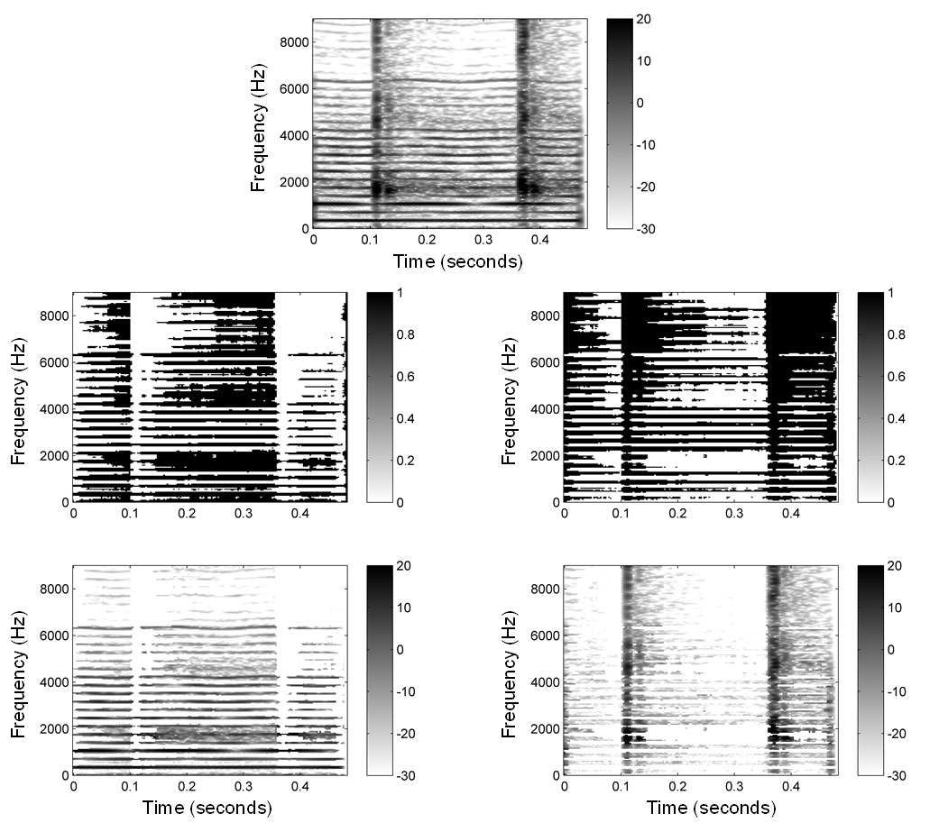
8.1 Harmonic–Percussive Separation
Fig. 8.6

Slide 11
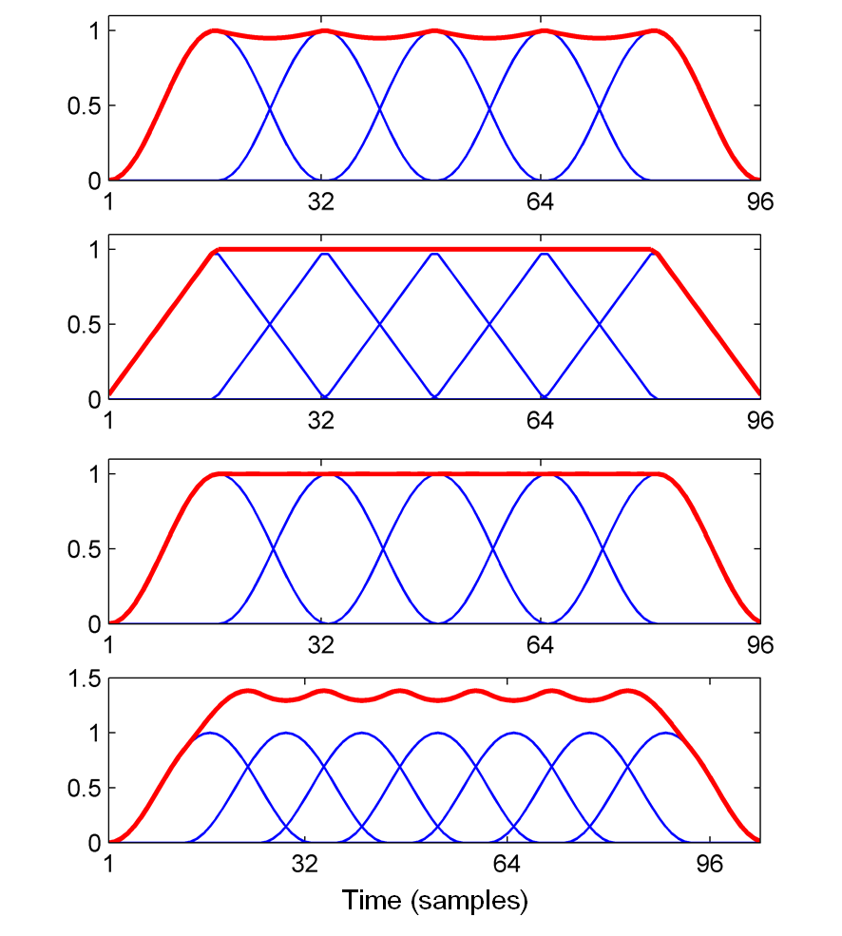
8.1 Harmonic–Percussive Separation
Fig. 8.7

Slide 12
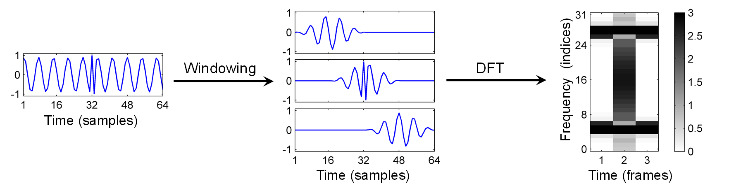
8.1 Harmonic–Percussive Separation
Fig. 8.8

Slide 13
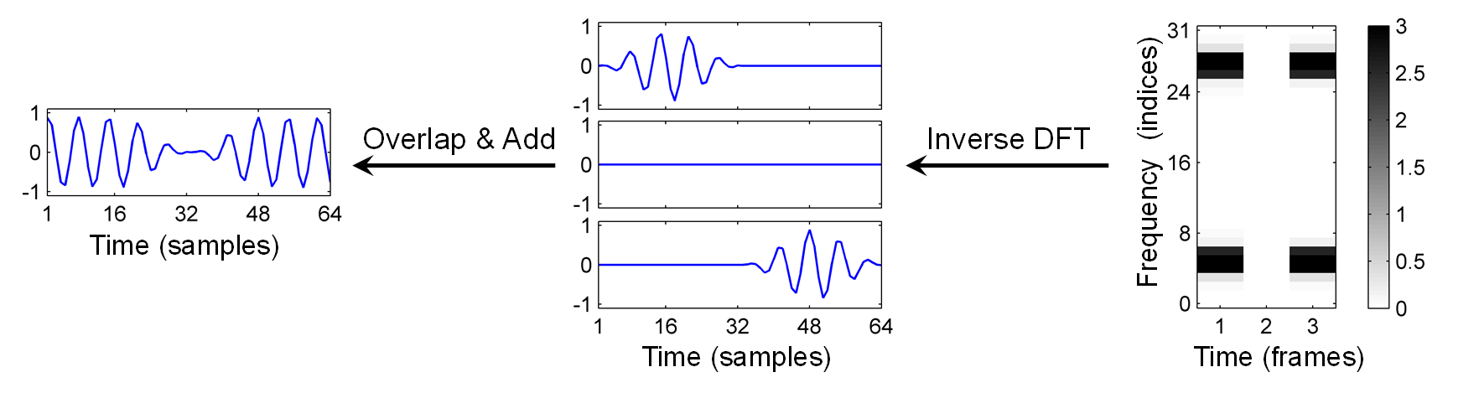

8.1 Harmonic–Percussive Separation
Fig. 8.8

Slide 14
8.1 Harmonic–Percussive Separation
Fig. 8.8

Slide 15
8.1 Harmonic–Percussive Separation
Fig. 8.8

Slide 16
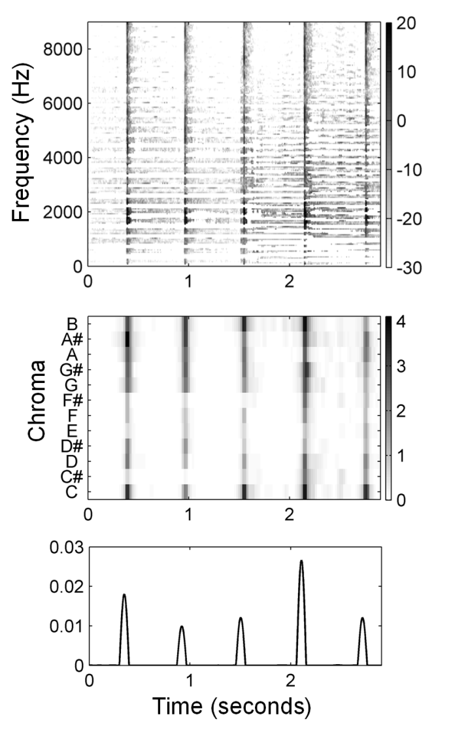
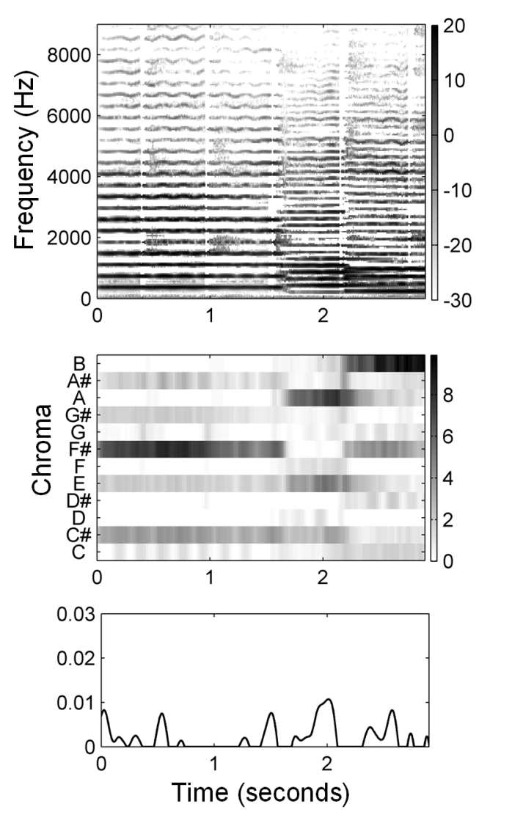
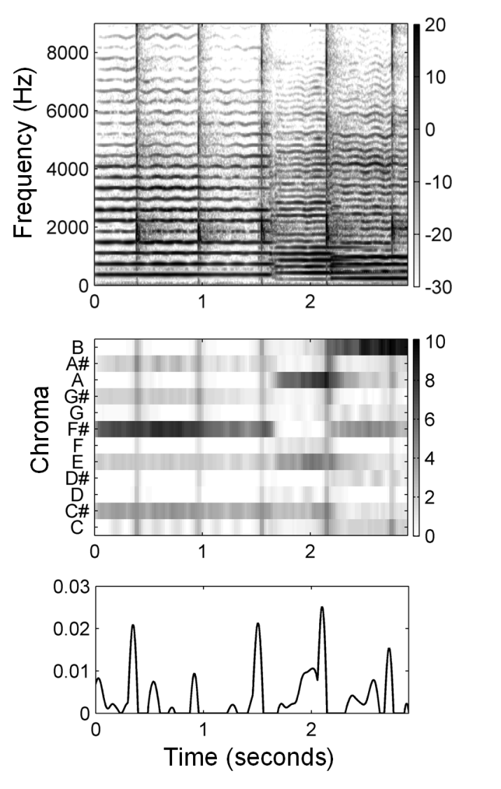
8.1 Harmonic–Percussive Separation
Fig. 8.9

Slide 17
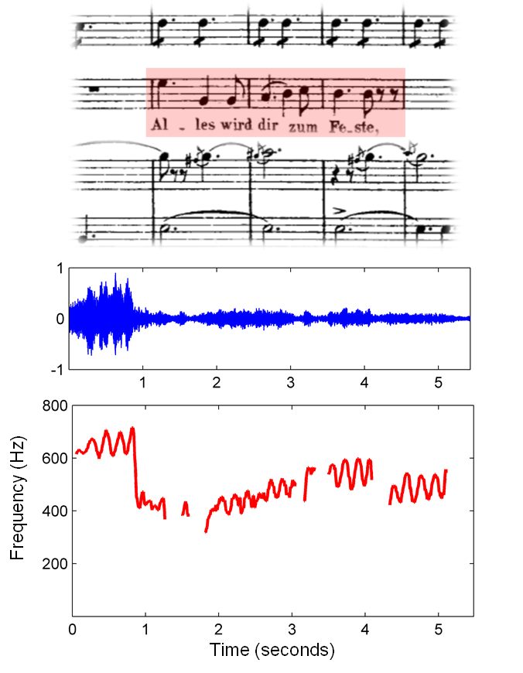
8.2 Melody Extraction
Fig. 8.10

Slide 18
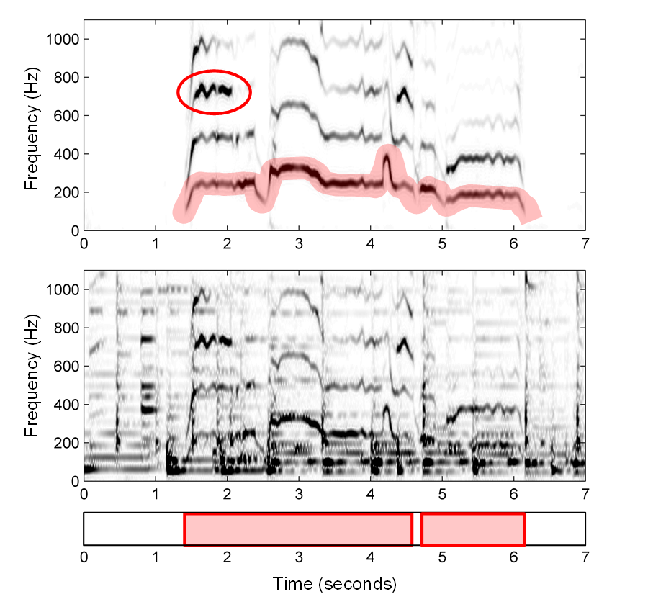
8.2 Melody Extraction
Fig. 8.11

Slide 19
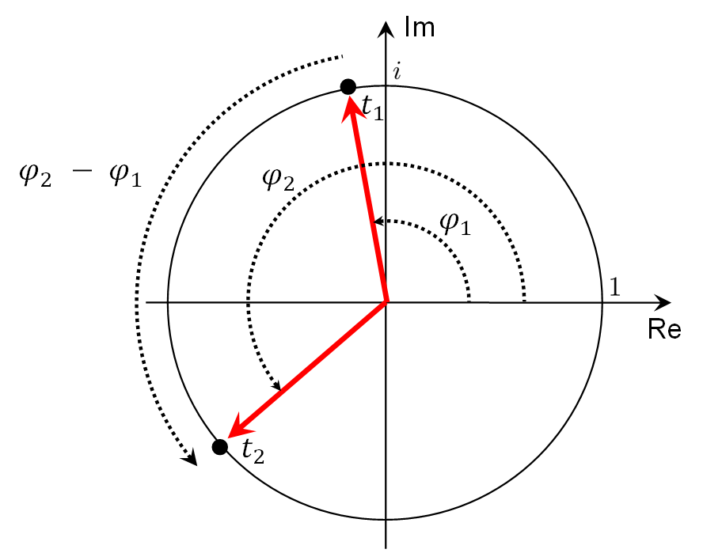
8.2 Melody Extraction
Fig. 8.12

Slide 20
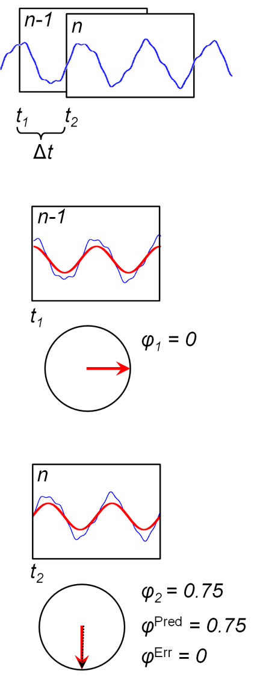
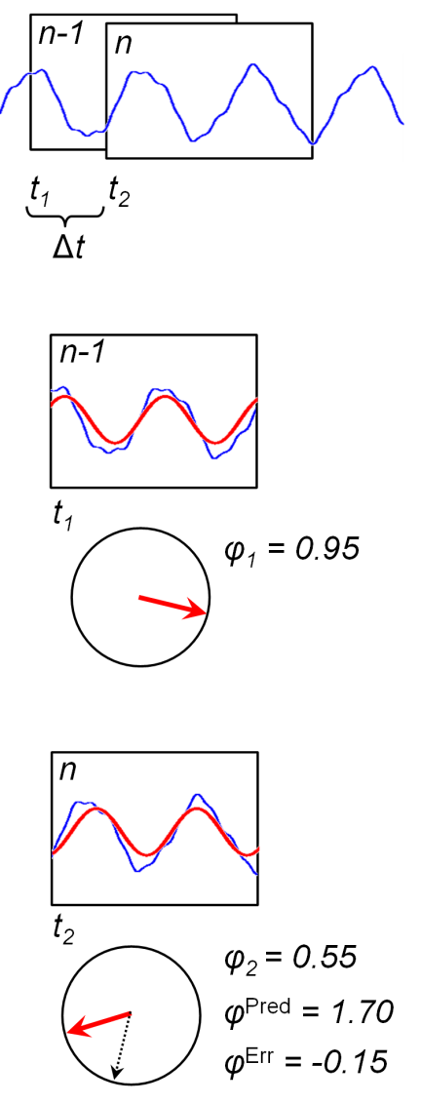
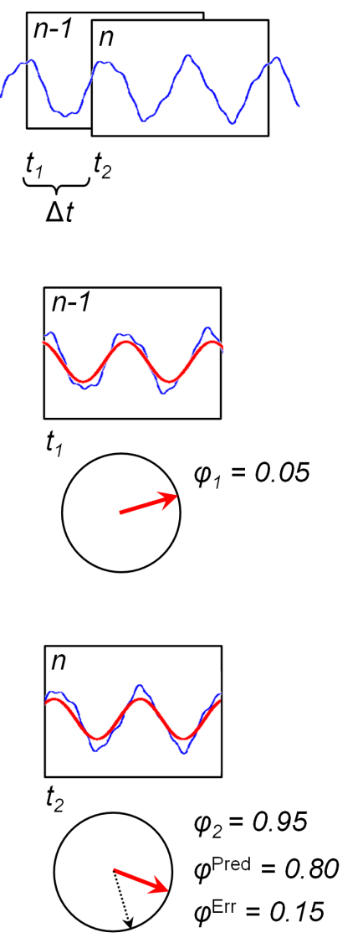
8.2 Melody Extraction
Fig. 8.13

Slide 21
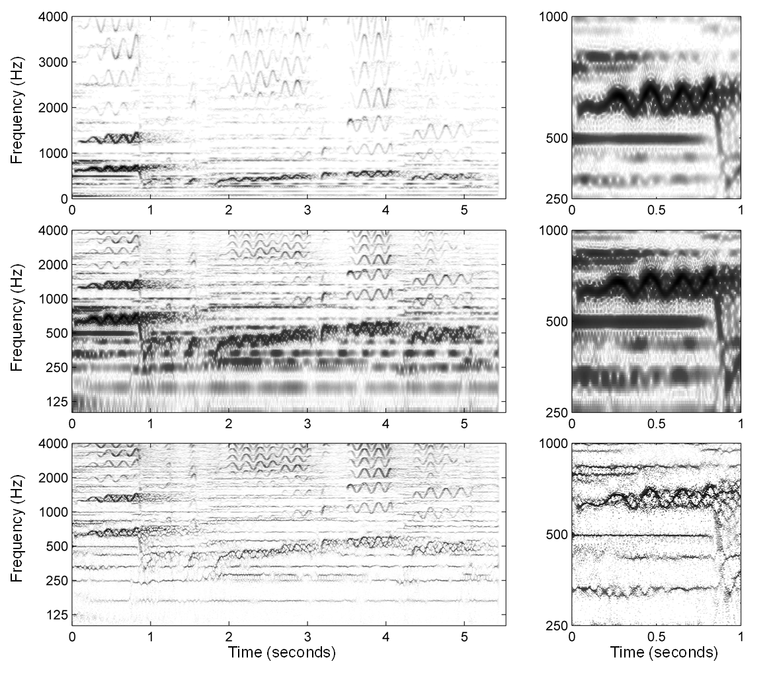
8.2 Melody Extraction
Fig. 8.14

Slide 22
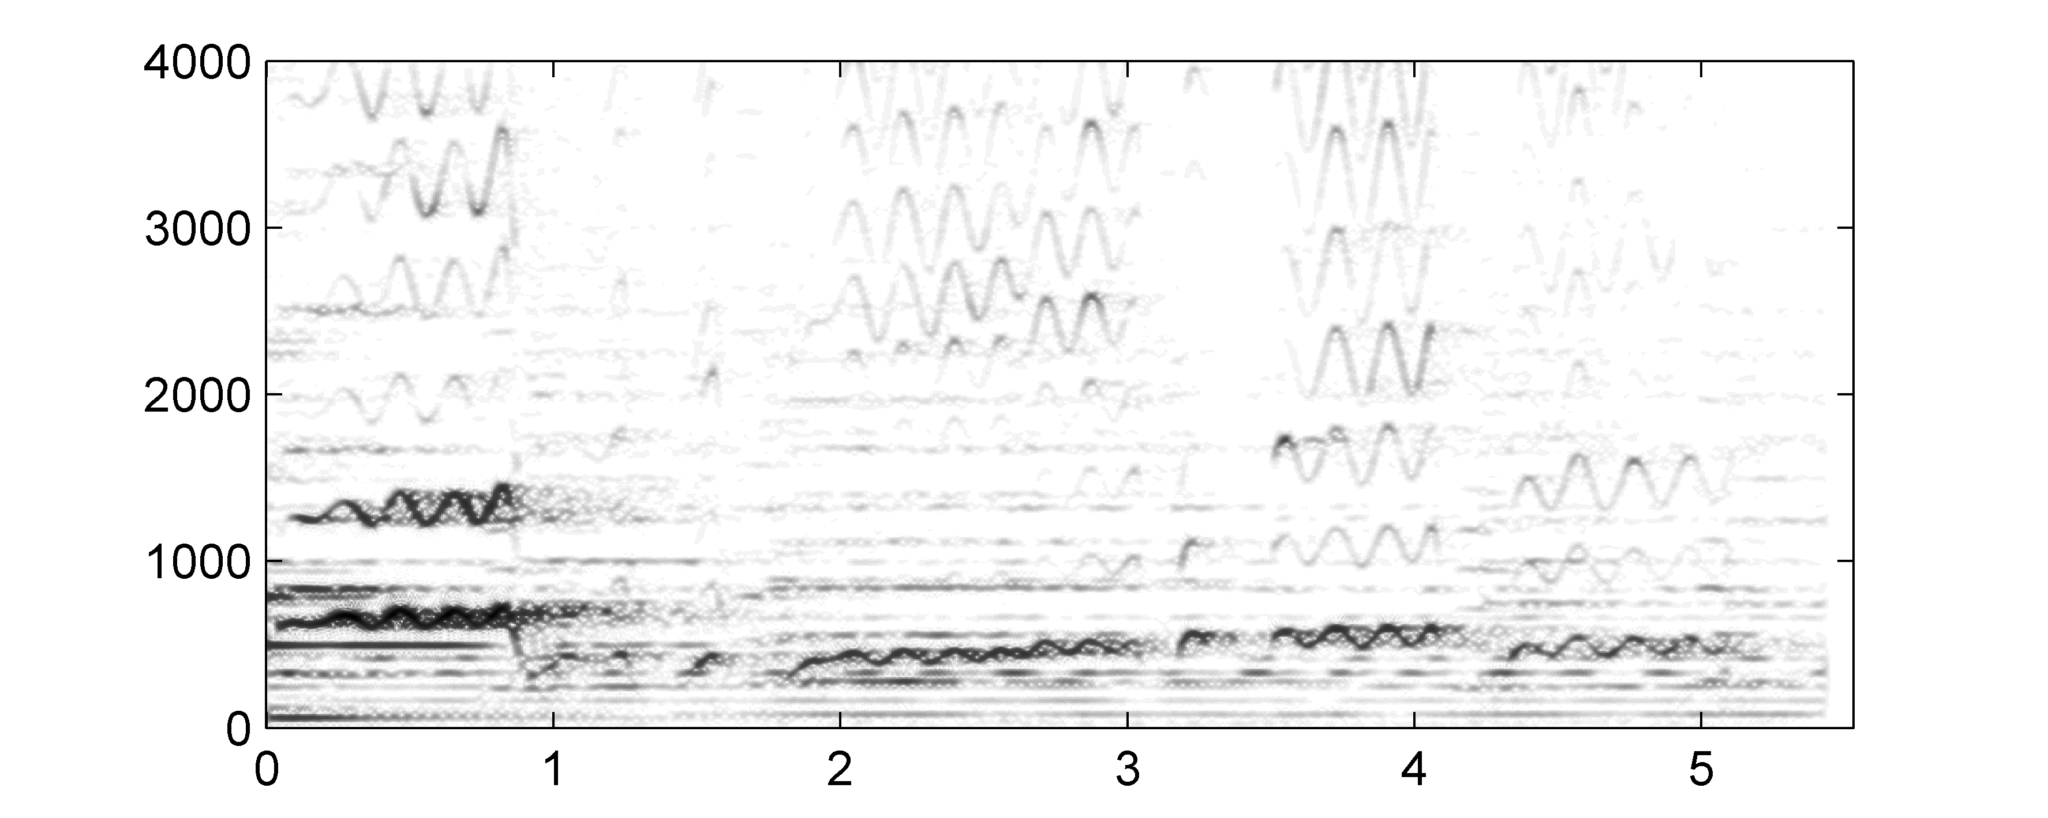
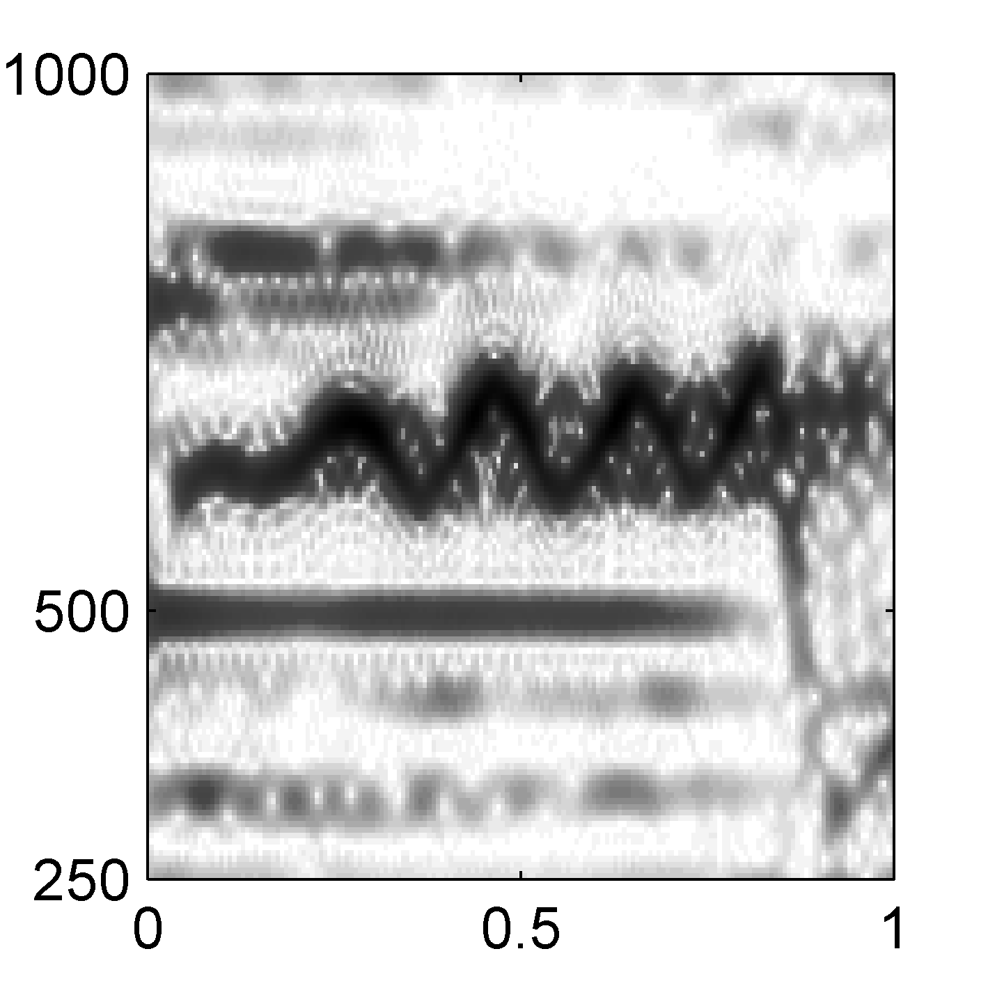
8.2 Melody Extraction
Fig. 8.14
Frequency (Hz)
Time (seconds)
Time (seconds)

Slide 23
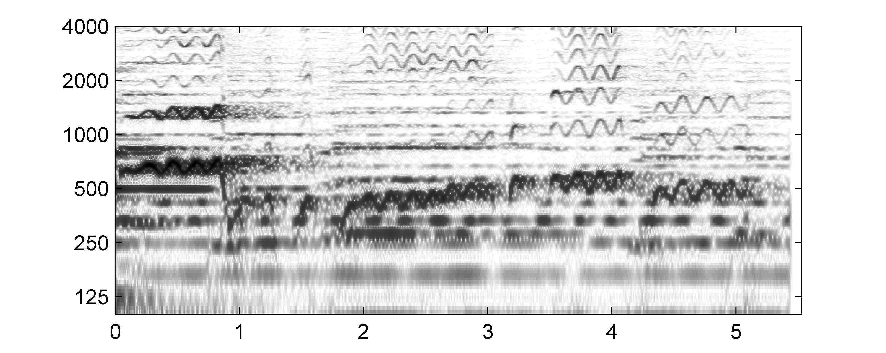
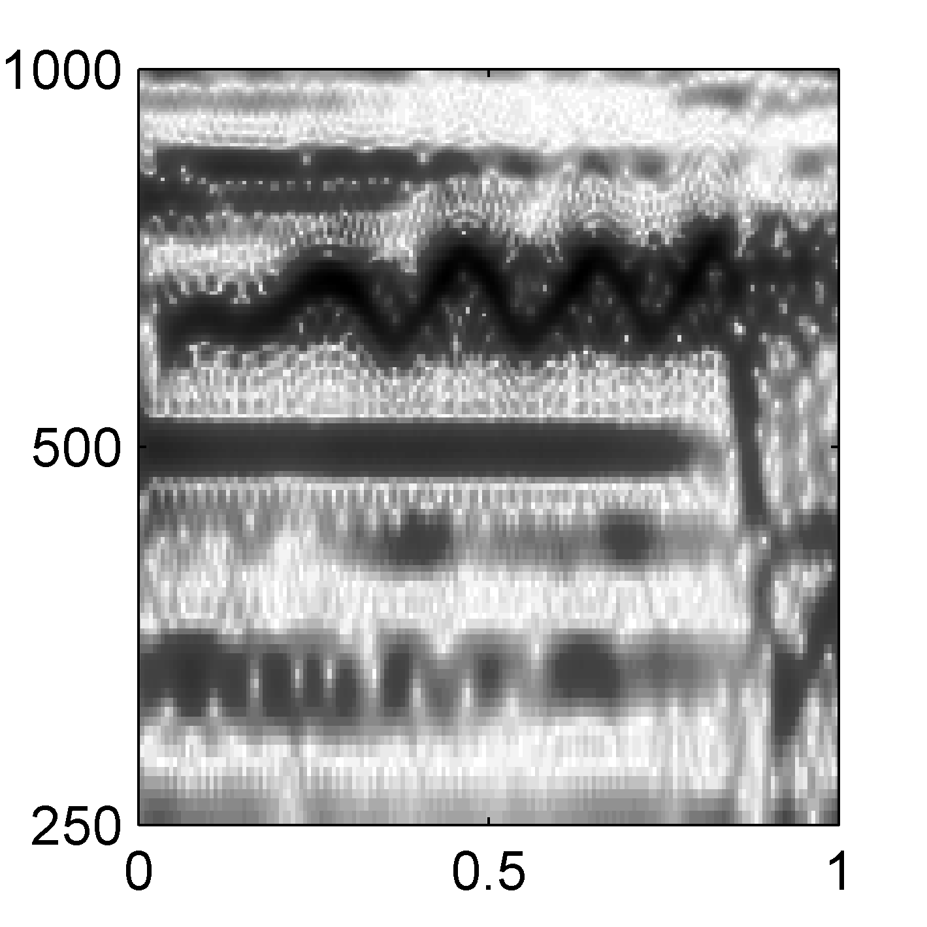
8.2 Melody Extraction
Fig. 8.14
Frequency (Hz)
Time (seconds)
Time (seconds)

Slide 24
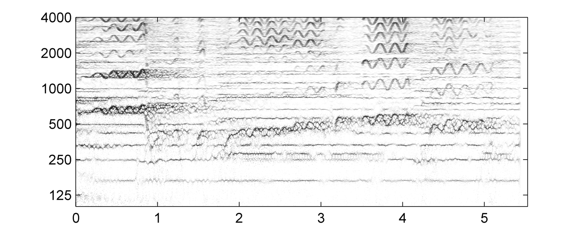
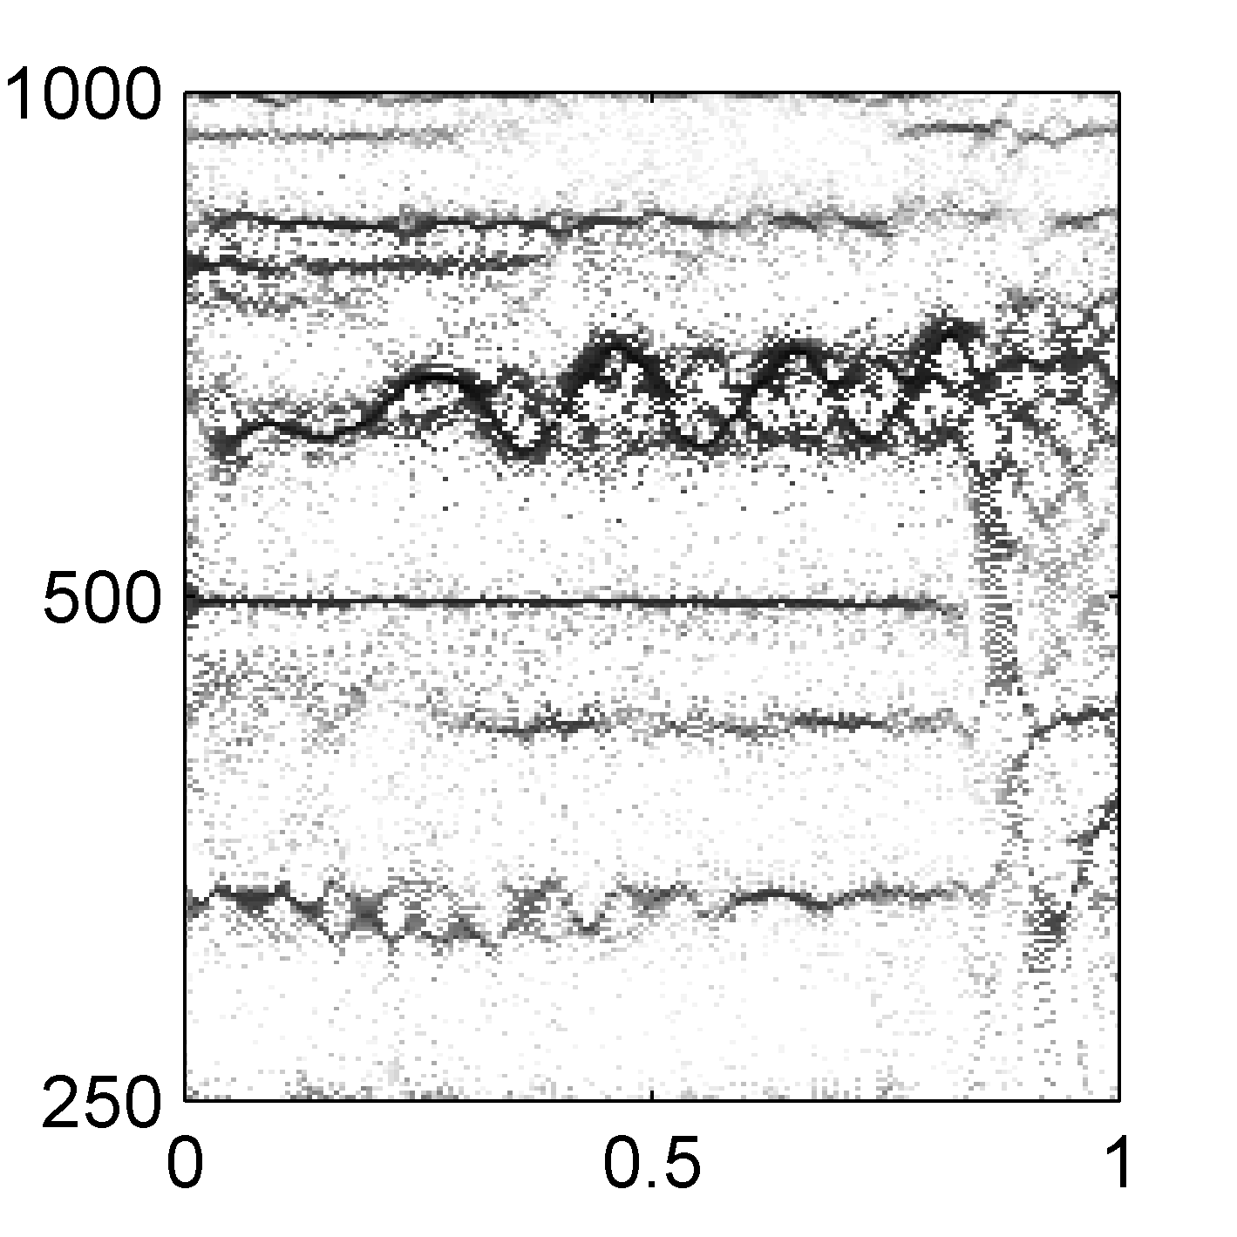
8.2 Melody Extraction
Fig. 8.14
Frequency (Hz)
Time (seconds)
Time (seconds)

Slide 25
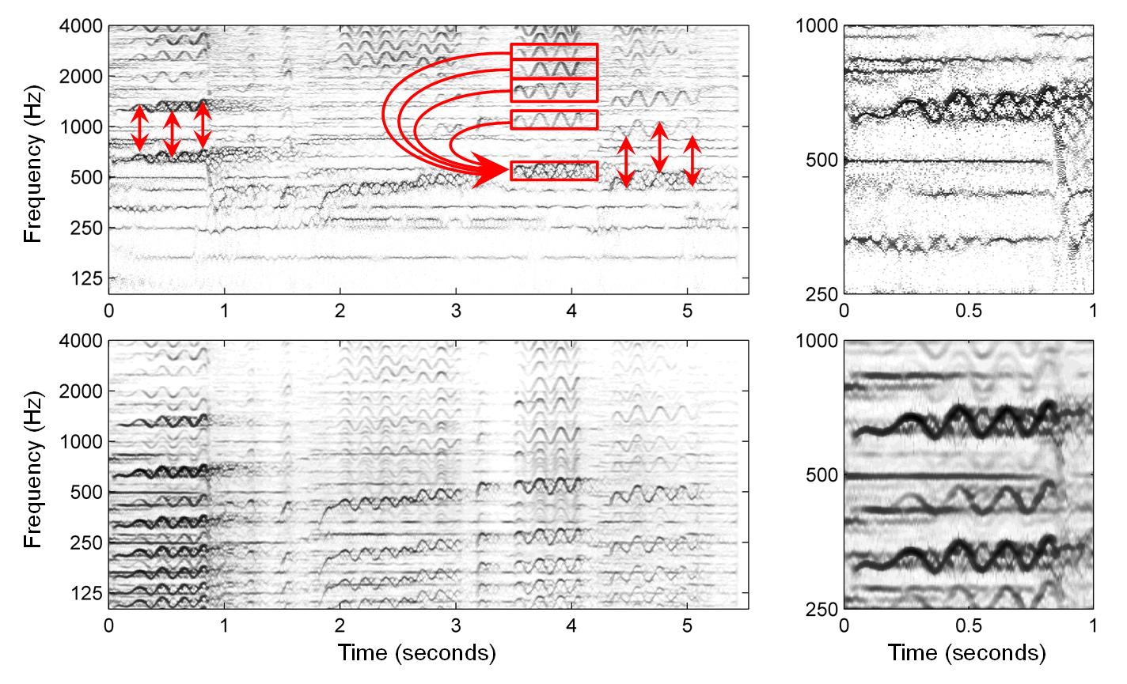
8.2 Melody Extraction
Fig. 8.15

Slide 26
8.2 Melody Extraction
Fig. 8.15
Frequency (Hz)
Time (seconds)
Time (seconds)

Slide 27
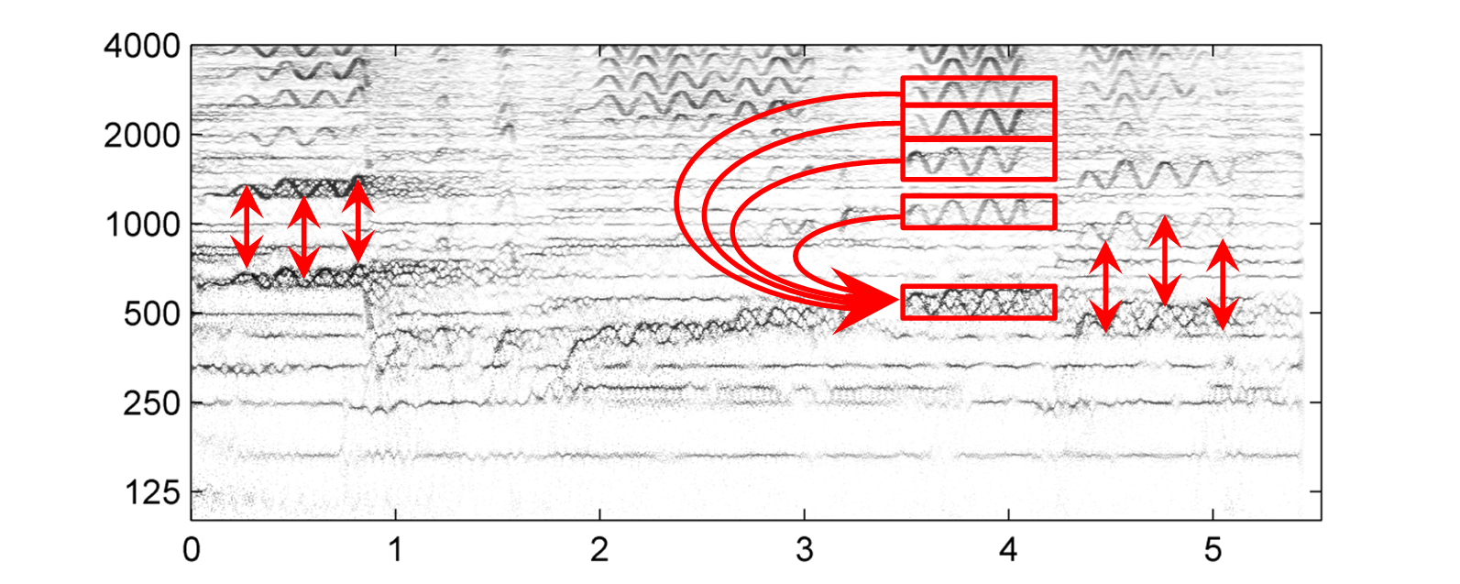
8.2 Melody Extraction
Fig. 8.15
Frequency (Hz)
Time (seconds)
Time (seconds)

Slide 28
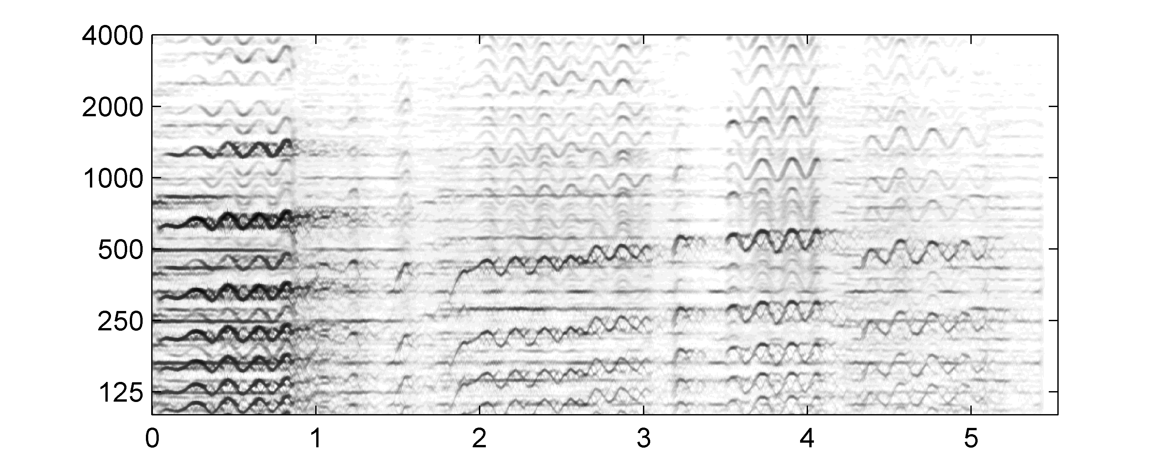
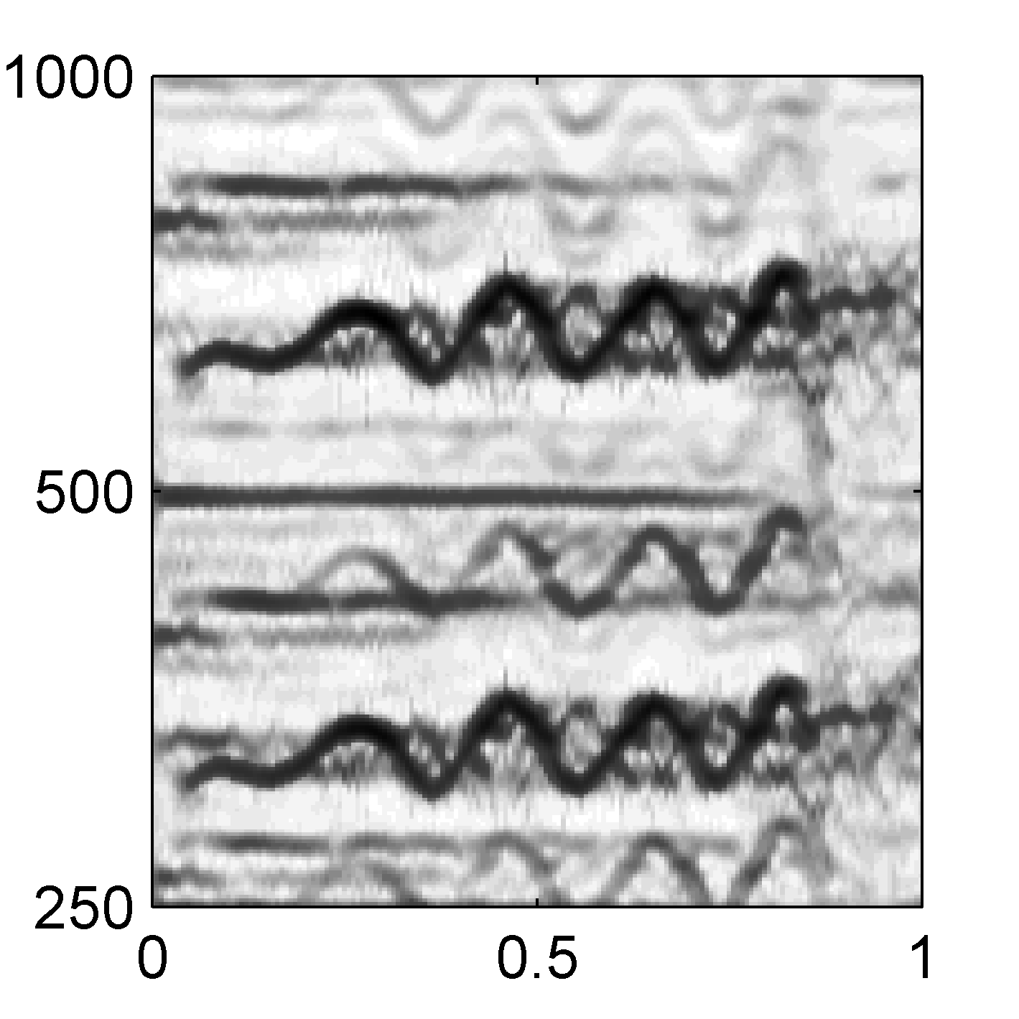
8.2 Melody Extraction
Fig. 8.15
Frequency (Hz)
Time (seconds)
Time (seconds)

Slide 29
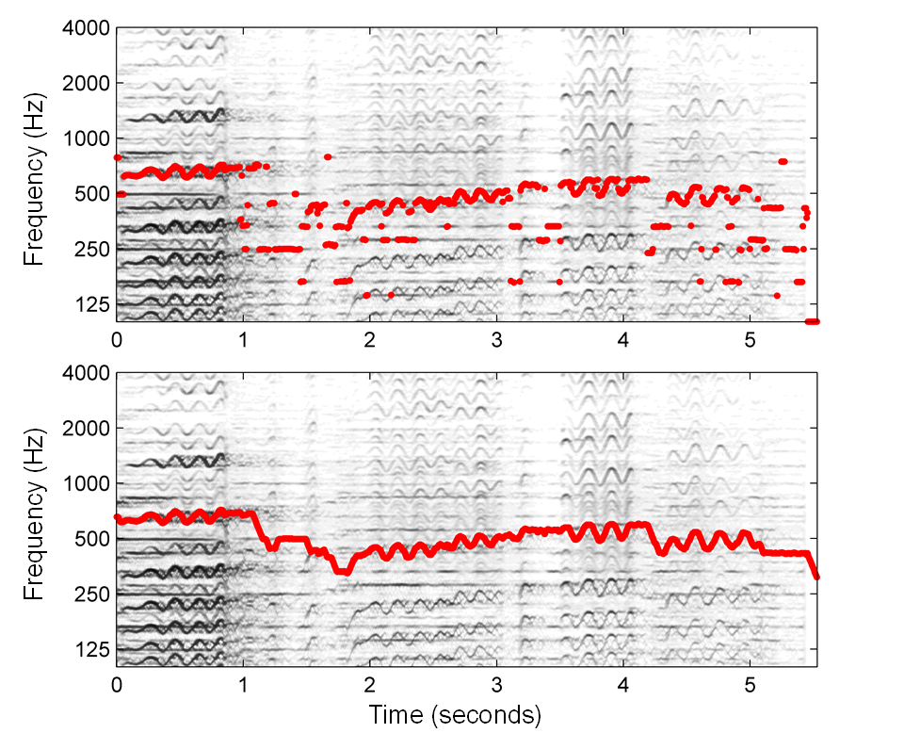
8.2 Melody Extraction
Fig. 8.16

Slide 30
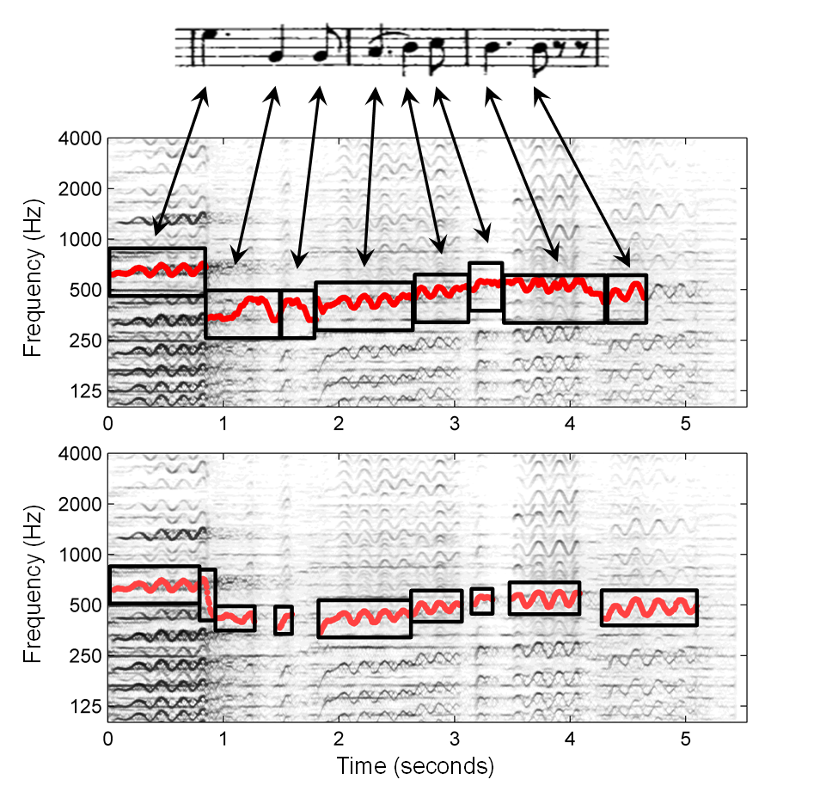
8.2 Melody Extraction
Fig. 8.17

Slide 31
8.2 Melody Extraction
Fig. 8.16
Frequency (Hz)
Time (seconds)

Slide 32
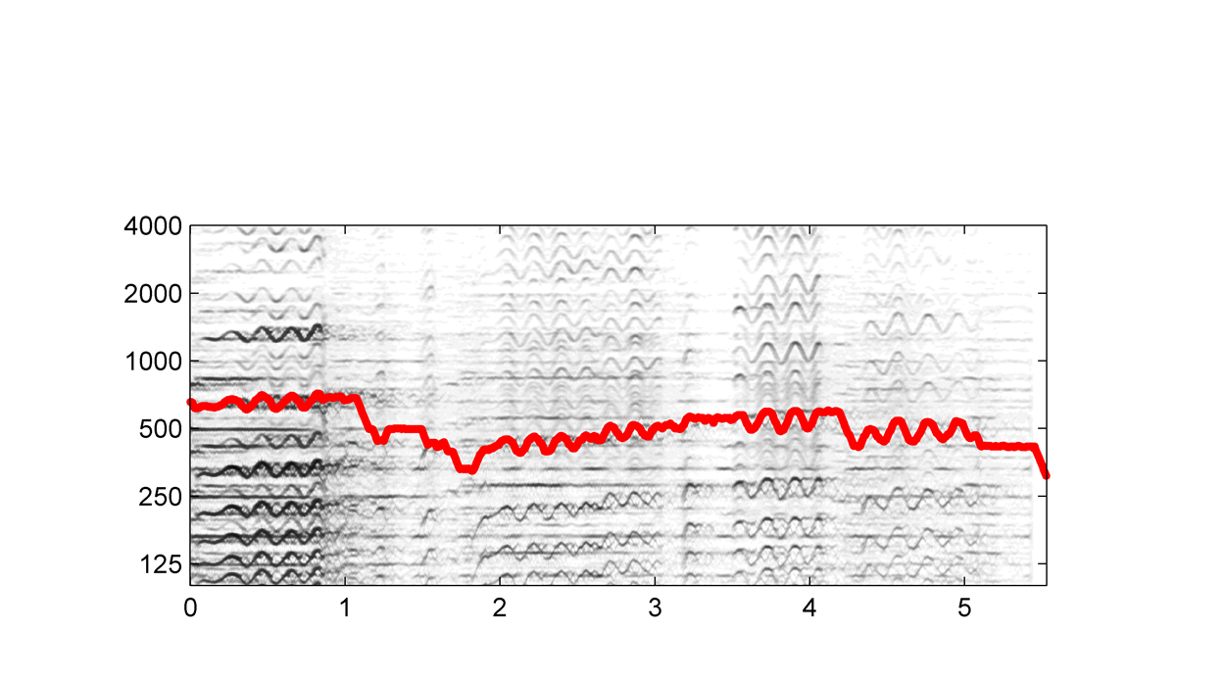
8.2 Melody Extraction
Fig. 8.16
Frequency (Hz)
Time (seconds)

Slide 33
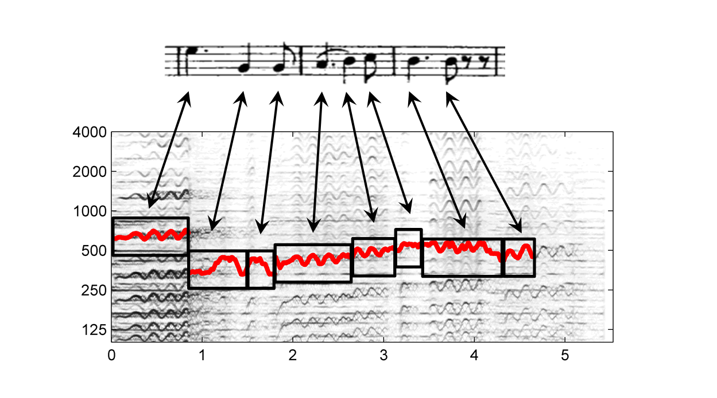
8.2 Melody Extraction
Fig. 8.17
Frequency (Hz)
Time (seconds)

Slide 34
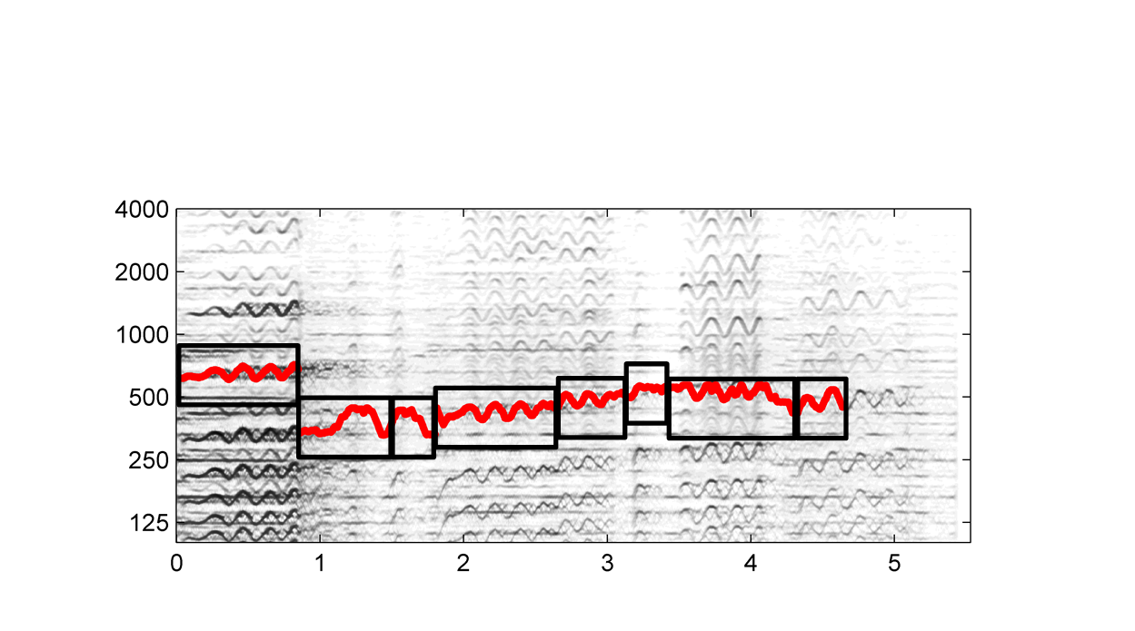
8.2 Melody Extraction
Fig. 8.17
Frequency (Hz)
Time (seconds)

Slide 35
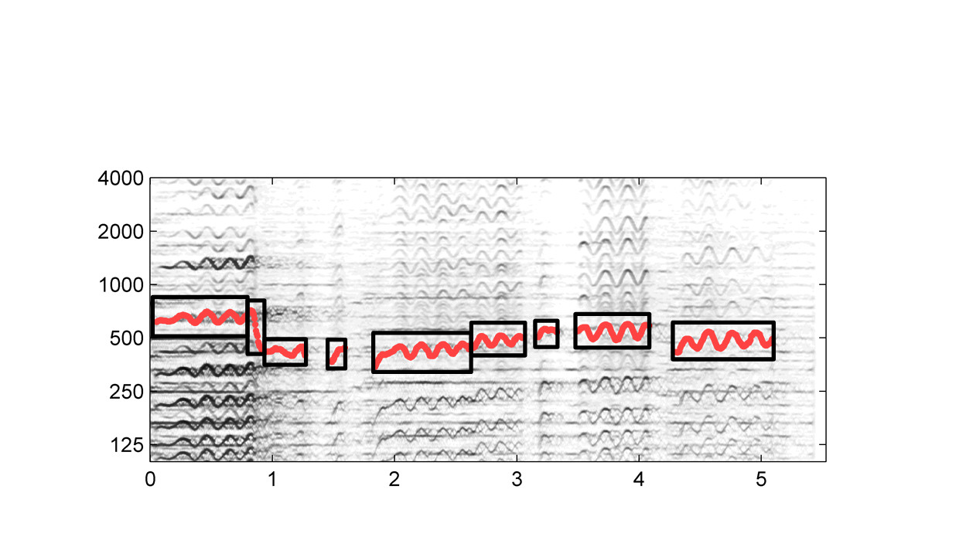
8.2 Melody Extraction
Fig. 8.17
Frequency (Hz)
Time (seconds)

Slide 36
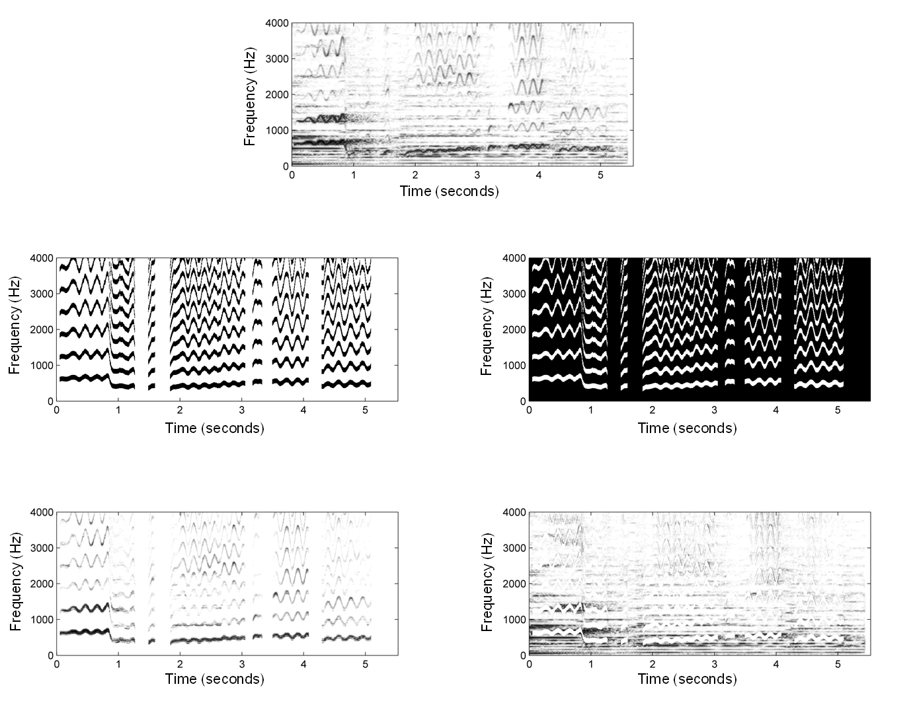
8.2 Melody Extraction
Fig. 8.18

Slide 37
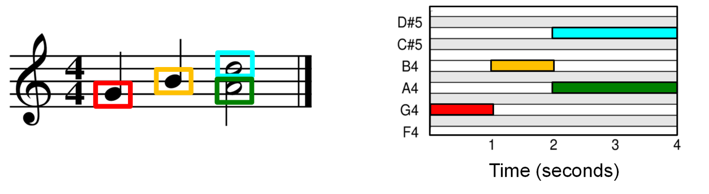
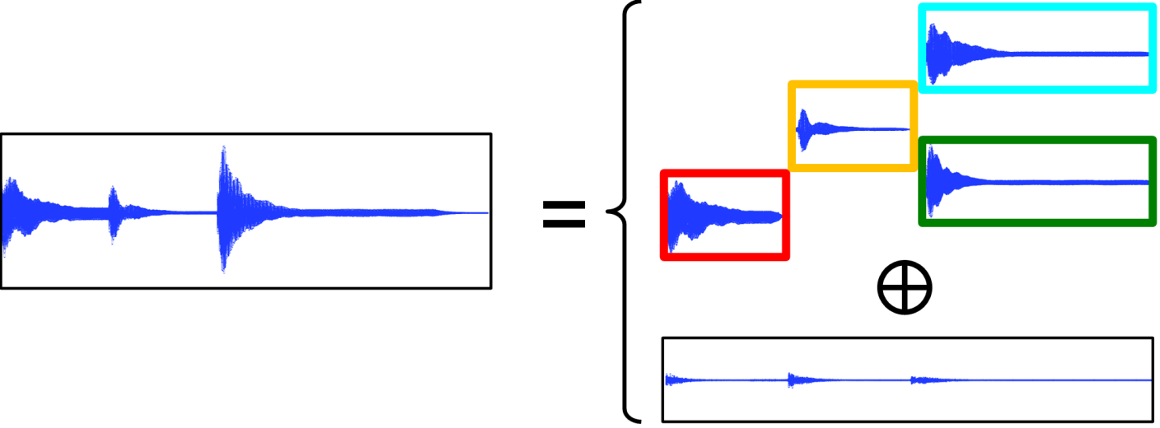
8.3 NMF-Based Audio Decomposition
Fig. 8.19

Slide 38
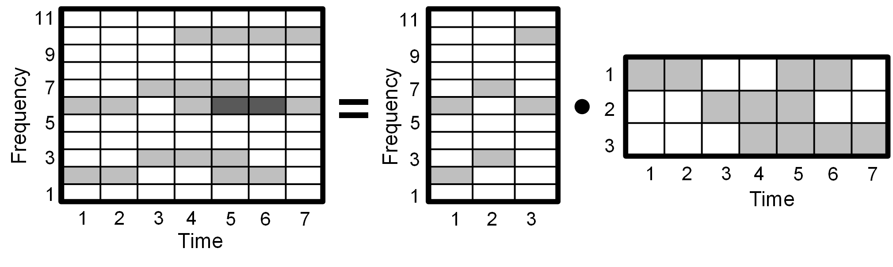
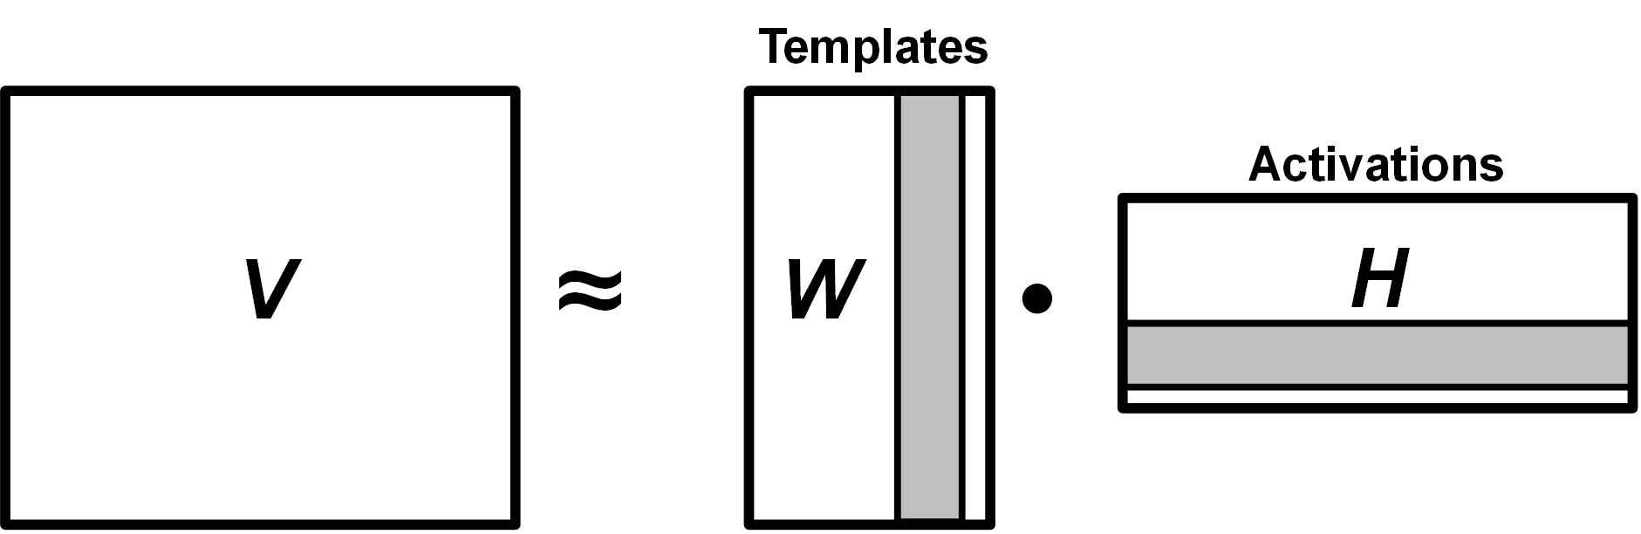
8.3 NMF-Based Audio Decomposition
Fig. 8.20

Slide 39
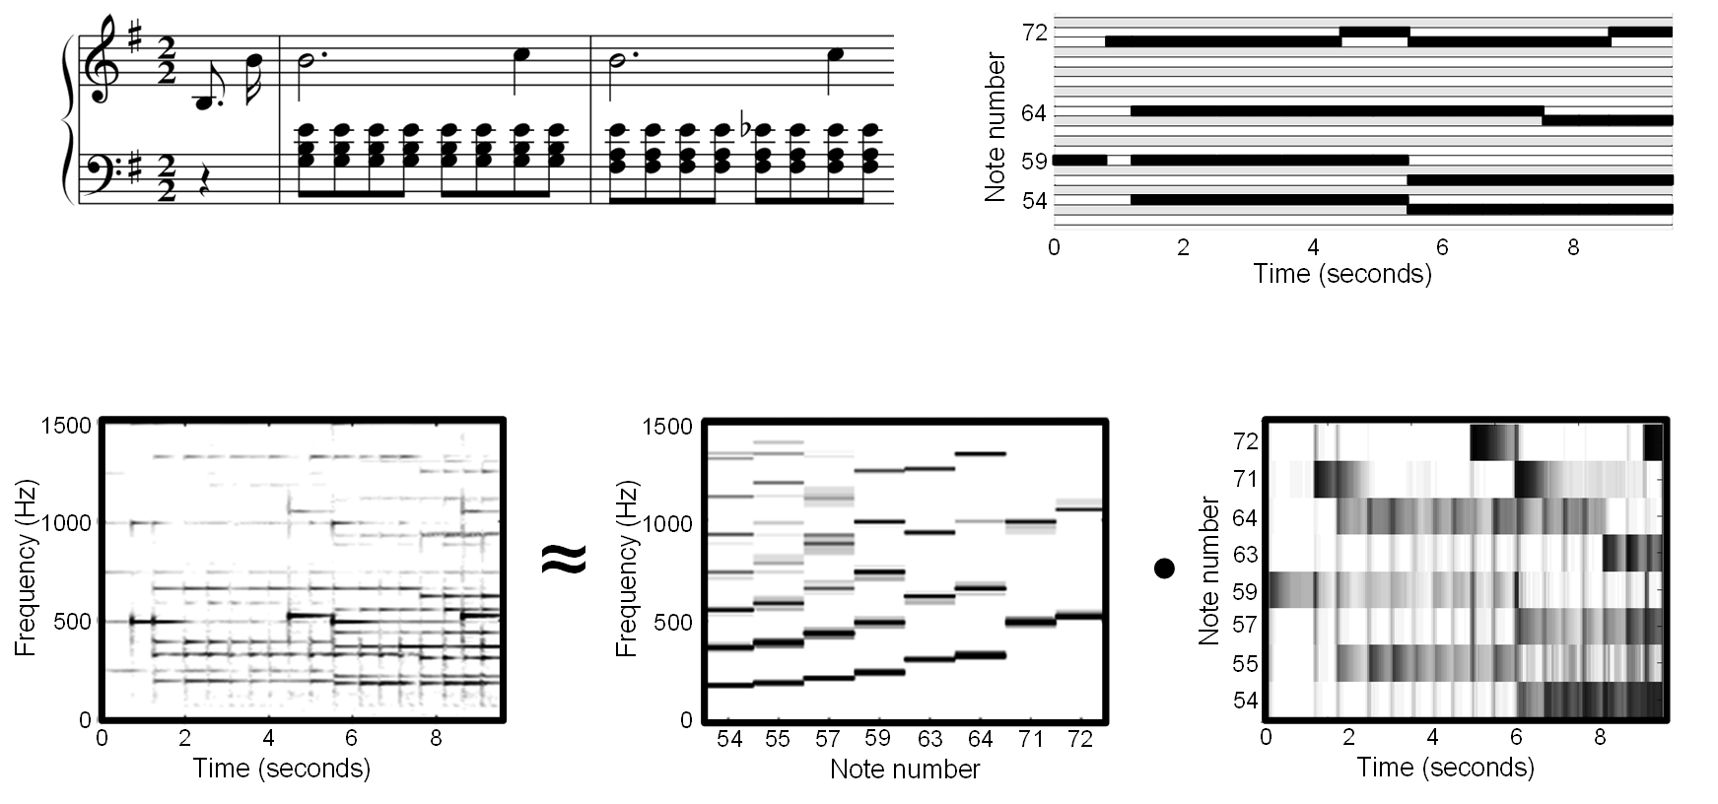
8.3 NMF-Based Audio Decomposition
Fig. 8.21

Slide 40
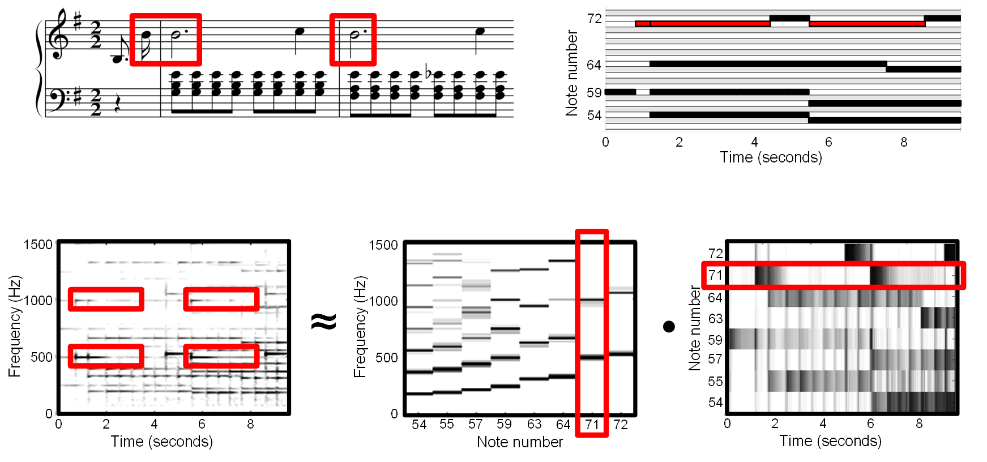
8.3 NMF-Based Audio Decomposition
Fig. 8.21

Slide 41
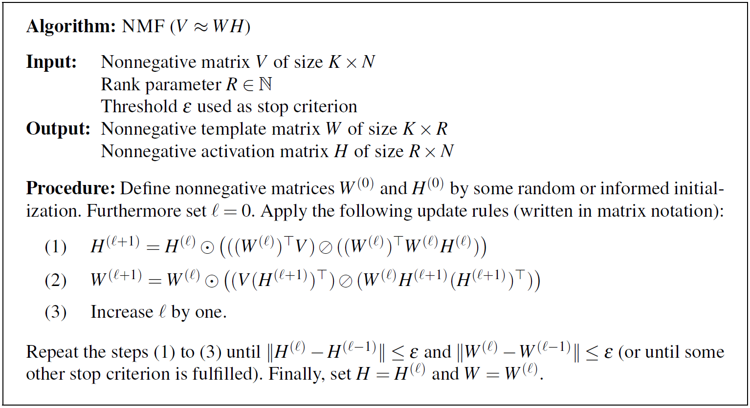
8.3 NMF-Based Audio Decomposition
Table 8.1

Slide 42
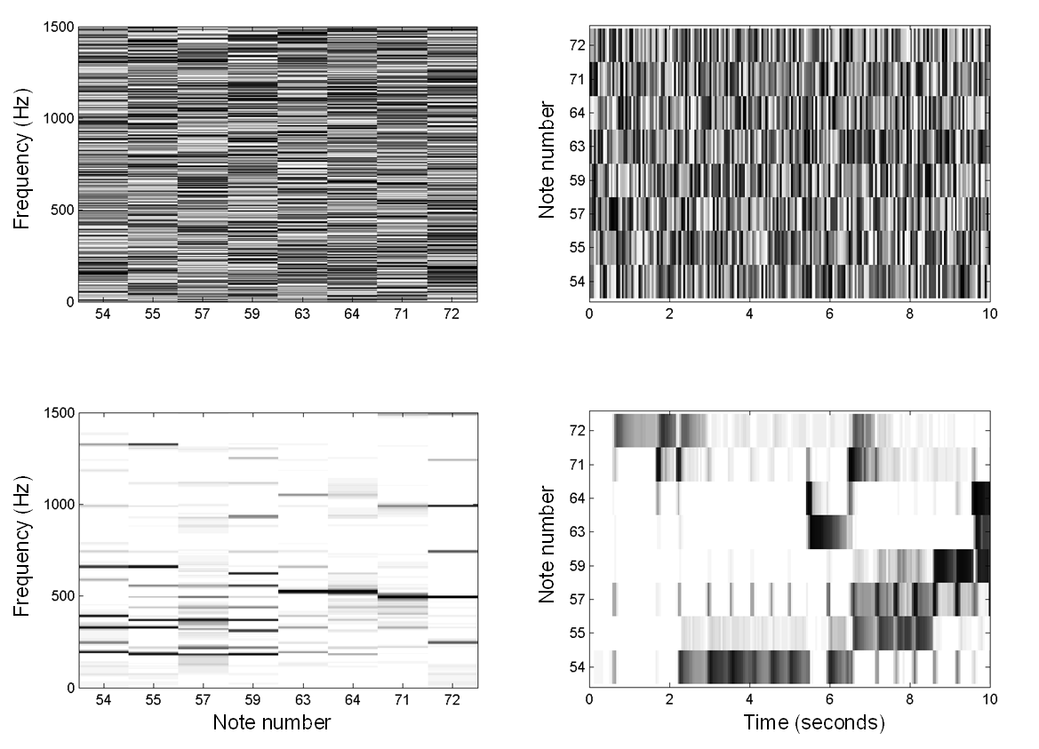
8.3 NMF-Based Audio Decomposition
Fig. 8.22

Slide 43
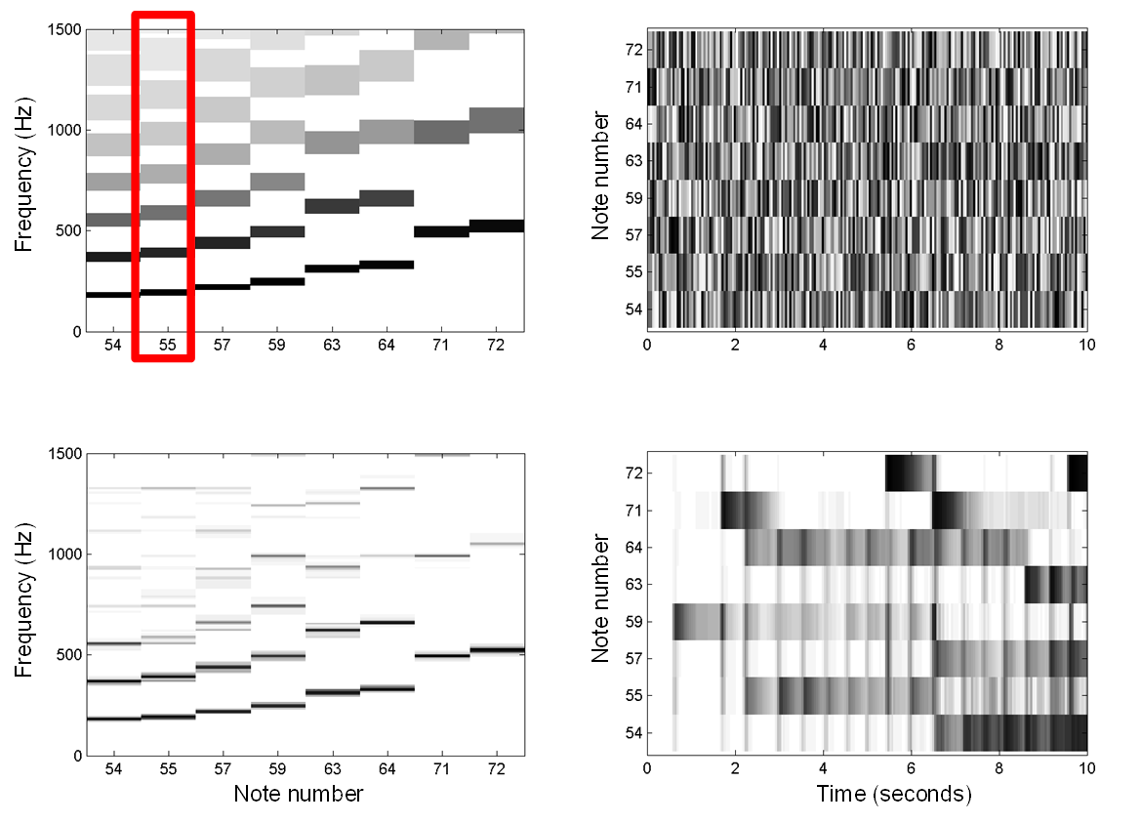
8.3 NMF-Based Audio Decomposition
Fig. 8.23

Slide 44
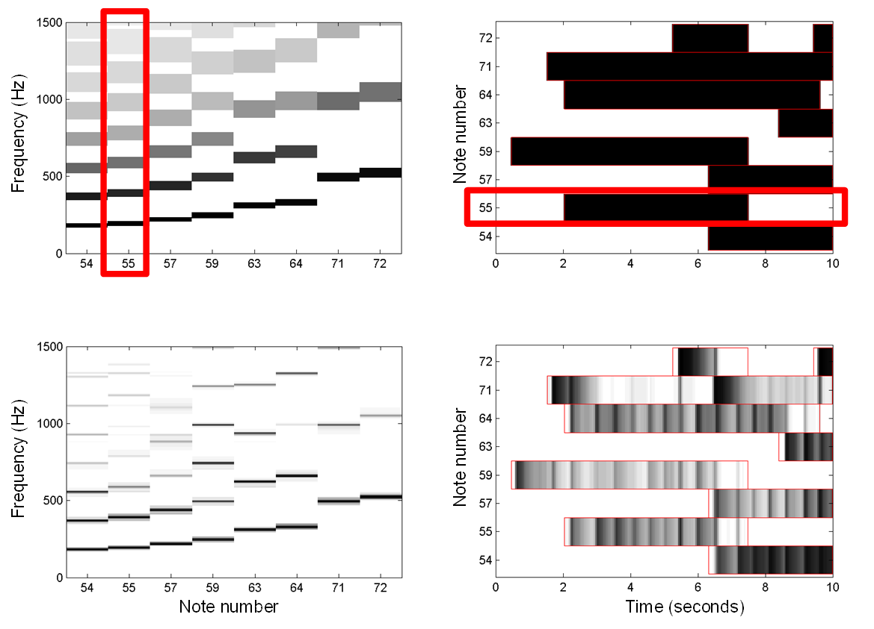
8.3 NMF-Based Audio Decomposition
Fig. 8.24

Slide 45

8.3 NMF-Based Audio Decomposition
Fig. 8.25

Slide 46

8.3 NMF-Based Audio Decomposition
Fig. 8.26

Slide 47


8.3 NMF-Based Audio Decomposition
Fig. 8.26
Note number
Time (seconds)

Slide 48


8.3 NMF-Based Audio Decomposition
Fig. 8.26
Note number
Note number
Time (seconds)
Time (seconds)

Slide 49

8.3 NMF-Based Audio Decomposition
Fig. 8.26
Frequency (Hz)
Frequency (Hz)
Time (seconds)
Time (seconds)

Slide 50

8.3 NMF-Based Audio Decomposition
Fig. 8.26
Frequency (Hz)
Frequency (Hz)
Time (seconds)
Time (seconds)

Slide 51


8.3 NMF-Based Audio Decomposition
Fig. 8.27

